Slide 1


Recitation 0.7
Git/Github
TA: Malihah & Khushee

Slide 2
Git
Git is a Version Control System.
Version Control System is a tool that helps to track changes in code
Why Git?
Free & open source
Fast and scalable

Slide 3
Github
Website that allows developers to store and manage their code using Git.
https://github.com

Slide 4
Setting up Git
Visual Studio Code
Windows (Git Bash)
Mac (Terminal)
git --version

Slide 5
Configuring Git
git config --global user.name “Khushee”
git config --global user.email “khushee@gmail.com”
git config --list

Slide 6
Github Account
Create a new repository : github-demo
Make our first commit

Slide 7
Clone & Status
Clone- Cloning a repository on our local machine
git clone <- some link ->
status- displays the status of the code
git status

Slide 8
Add & Commit
add- adds new or changed files in your working directory to the Git staging area.
git add <- file name ->
commit- it is the record of change
git commit -m “some message”

Slide 9
Push Command
Push- upload local repo content to remote repo
git push origin main

Slide 10
Init Command
git init
git remote add origin <-link->
git remote -v
git branch
git branch -M main
git push origin main

Slide 11
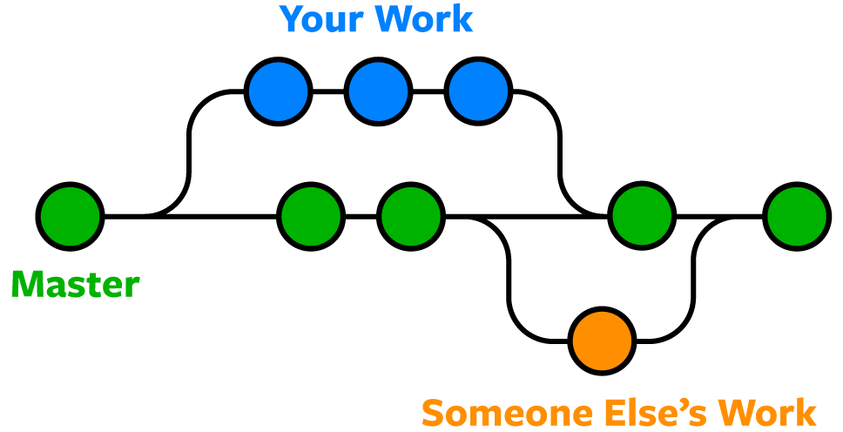
Git Branches

Slide 12
Branch Command
git branch (to check branch)
git branch - M main (to rename branch)
git checkout <-branch name-> (to navigate)
git checkout -b <-new branch name-> (to create new branch)
git branch -d <- branch name-> (to delete branch)

Slide 13
Merging Code
Way 1
git diff <-branch name-> (to compare commits, branches, files & more)
git merge <-branch name-> (to merge 2 branches)
Way 2
Create a PR

